Slide 1
Azure Defender for IoT
200.6 Data Mining (Baseline)

Slide 2
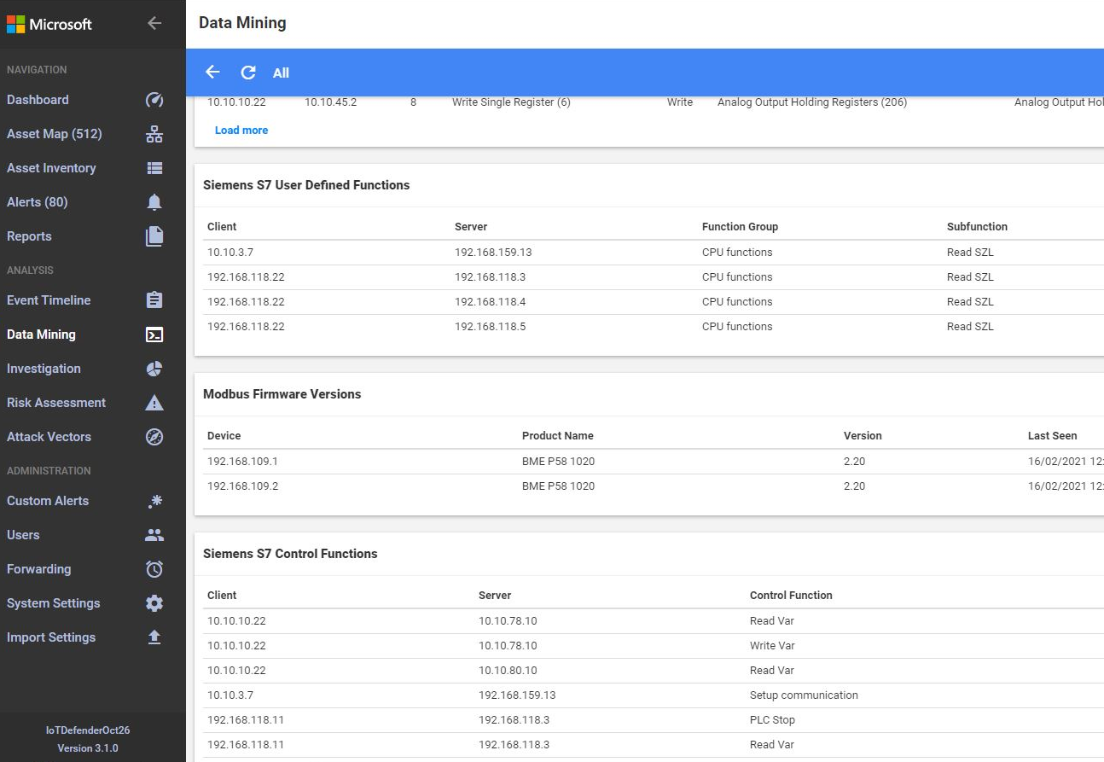

Data Mining
What is it?
Offers comprehensive and granular information about assets and their communication
When to use it?
Customize your baseline
Finetune reports for specific needs
Benefits
Support incident response with real time data
Reports with historic data
Identify network integrity, for example by filtering against assets with weak authentication credentials

Slide 3
Thank you

